Slide 1
IoT environment dashboard

Slide 2
Presented by
M.SRIVIDYA
N.SANVITHA
J.AKSHITHA
G.SANJANA
B.ANJALI

Slide 3

PROBLEM STATEMENT
THE PROBLEM:
-Manual monitoring is time-consuming.
-Environmental data is not continuously available.
-Difficult to monitor conditions remotely.
-Limited real-time visualization.

Slide 4

Proposed solution
OUR SOLUTION:
IOT ENIVRONMENTAL DASHBOARD
A Smart platform that collects environmental data and presents it through a real-time dashboard.
MAIN PARAMETERS:
Temperature
Humidity
Environmental Status

Slide 5
objective
Monitor temperature
Monitor humidity
Visualize data in real time
Display environmental status
Enable remote monitoring

Slide 6
System architecture
DHT11 SENSOR
ESP32
WI-FI
AWS IOT CORE
DASHBOARD
AMAZON S3
AWS LAMBDA

Slide 7
TECHNOLOGY STACK
TECHNOLOGY
ESP32
DHT11
OLED
AWS IOT CORE
LAMBDA
S3
HTML/CSS/JS
PURPOSE
Data collection &wifi
Temperature&humidity
Local display
Iot communication
Data processing
Data storage
Dashboard

Slide 8

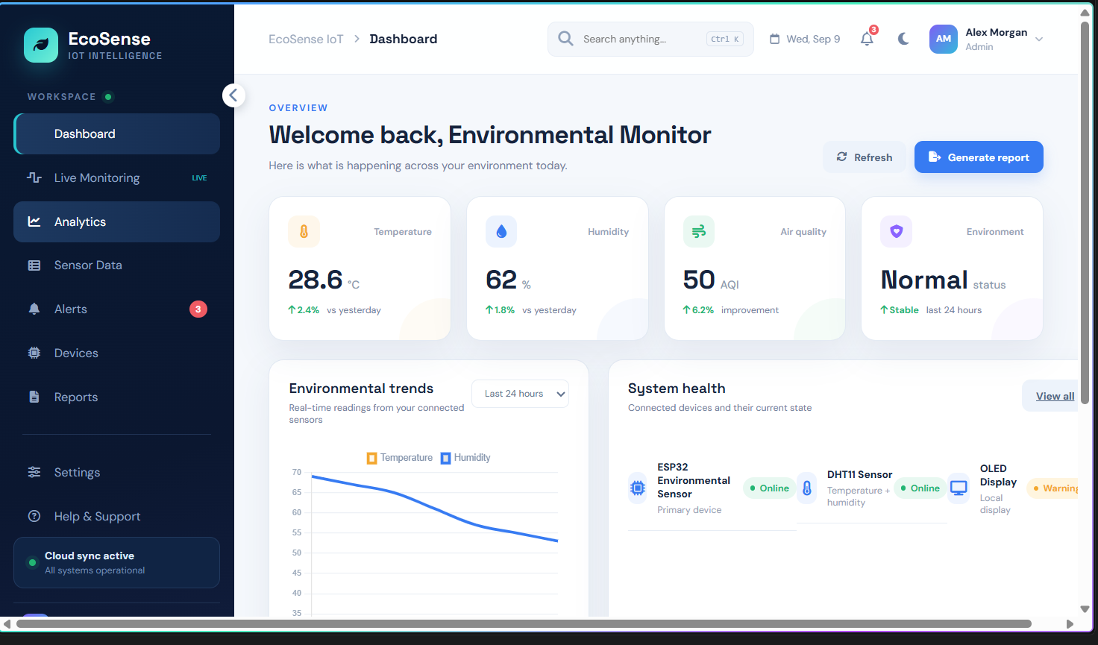
dashboard

Slide 9

Working process
SENSE
COLLECT
TRANSMIT
PROCESS
STORE
VISUALIZE

Slide 10
KEY FEATURES
-TEMPERATURE MONITORING
-HUMIDITY MONITORING
-REAL-TIME GRAPHS
-STATUS MONITORING
-CLOUD INTEGRATION
-REMOTE ACCESSIBILITY

Slide 11
APPLICATIONS&FUTURE SCOPES
APPLICATIONS
-Smart Homes
-Smart Agriculture
-Laboratories
-Offices
-Industrial monitoring
FUTURE SCOPE
-Mobile application
-Automatic alerts
-More sensors
-AI-Based prediction
-Advanced analytics

Slide 12
Thank you

